Slide 1
Web-based e-commerce online store of outdoor gear - SteelPoint
Presentation Author: Valentin Ozerov
Individual Project

Slide 2
Outline
Outline
Plan for the presentation
Main Idea of the Work
Platform and Technologies
Results and Schedule
From Prototype to Implementation
Difficulties During Implementation
Testing Methodologies
Examples of Use
Future Plans
Valentin Ozerov
Individual Project

Slide 3
Main Idea of the Work
Main Idea of the Work
Outdoor Gear E-Commerce
SteelPoint is a web-based e-commerce application designed to simulate an online store for outdoor gear such as knives, multitools, machetes, axes, and tactical shovels.
The project addresses the challenge of creating a fast, responsive, and interactive online store where users can explore, filter, and sort products, add them to a shopping cart, and mark favorites for quick access.
This prototype demonstrates the practical use of modern web technologies in real-world e-commerce applications.
Valentin Ozerov
Individual Project

Slide 4
Platform and Technologies
Platform and Technologies
Vue-Spring Platform
Platform: Web (SPA - Single Page Application)
Frontend: Vue.js 3, Vue Router, SCSS
Backend: Spring Boot (Java 17), REST API, H2 (in-memory database)
Development Tools:
Visual Studio Code (frontend)
IntelliJ IDEA (backend)
GitHub for version control
Valentin Ozerov
Individual Project

Slide 5
Results and Schedule
Results and Schedule
SteelPoint: E-commerce Prototype
All planned major features for this project were successfully completed on time:
✔ Main catalogue with pagination ✔ Filtering and sorting by category, name, and price ✔ Favorites page with management features ✔ Shopping cart with total calculation ✔ REST API providing product data
Product detail pages and user profile are partially developed and marked for future completion.
Valentin Ozerov
Foreign Language
Individual Project

Slide 6
From Prototype to Implementation
Initial Design vs Current Version
Project’s progress
Prototype: Basic wireframes drawn for homepage, cart drawer, and product cards.
Current Version: Fully functional Vue components with modern SCSS styling, grid-based layout, and interactive elements (hover effects, skeleton loaders, etc.)
📷 (Insert before/after comparison screenshots)
Valentin Ozerov
Individual Project

Slide 7
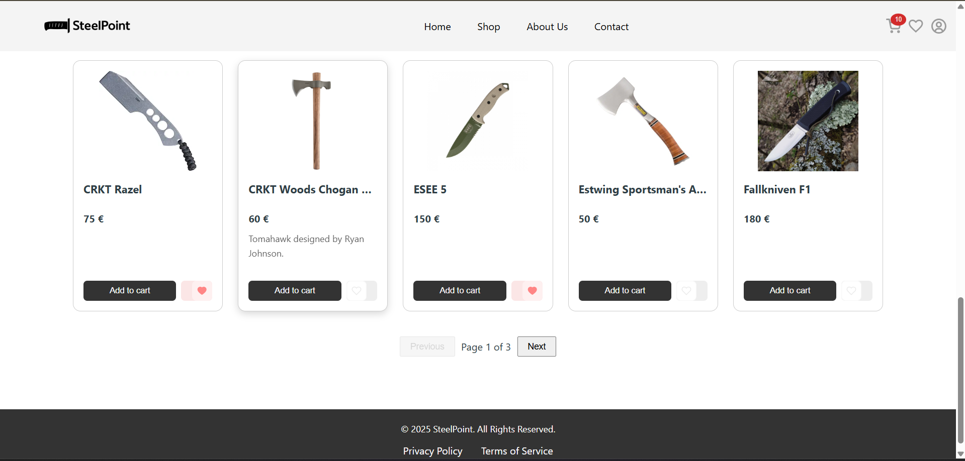
Current Version I
Current Version
Main page with Pagination
Fig. 1 - Main Product Catalogue with Pagination and Product Cards
Valentin Ozerov
Individual Project

Slide 8
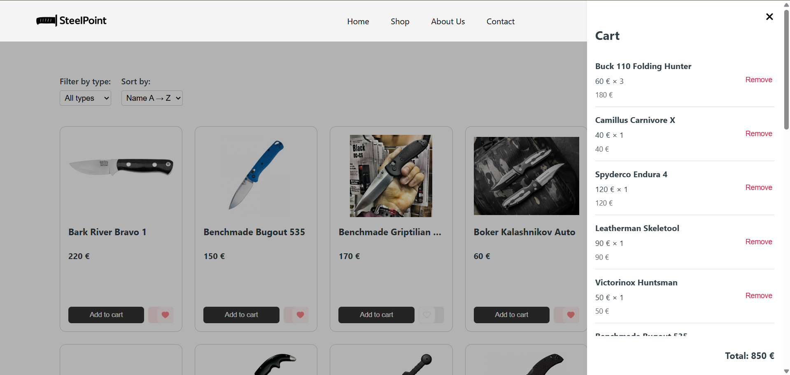
Current Version II
Current Version
Open cart
Fig. 2 - Shopping Cart Drawer with Selected Items
Valentin Ozerov
Individual Project

Slide 9
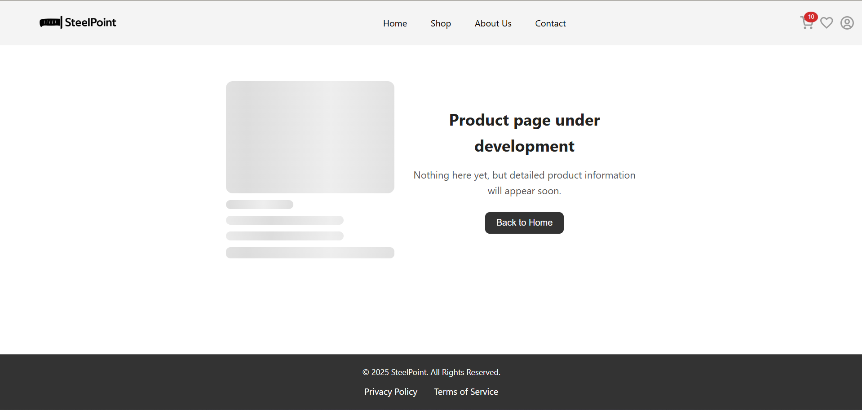
Current Version III
Current Version
Skeleton loader on /product/:id page
Fig. 3 - Product Detail Placeholder Page with Skeleton Loader
Valentin Ozerov
Individual Project

Slide 10
Difficulties During Implementation
Difficulties During Implementation
Challenges Encountered
Designing DTOs for clean separation between database models and API responses.
Filtering logic between client and server sides had to be unified for consistency.
Designing a flexible and scalable component structure required careful planning.
Failed deployment attempts on Render and Heroku led to additional time spent selecting alternatives.
Matching documentation content (screenshots, diagrams, code, gifs) with the final project version.
Time-consuming preparation of complete well-structured academic documentation.
Valentin Ozerov
Individual Project

Slide 11
Testing Methodologies
Testing Methodologies
Manual Testing
One example unit test for the favorites feature (toggleFavorite) was written specifically for coursework requirements, but it was not actively used during testing. Integration tests were not implemented in the prototype.
COVERAGE: ✔ Manual testing – tested about 90-95% of functionality
✔ Automated tests – 1 demonstration unit test only
Valentin Ozerov
Individual Project

Slide 12
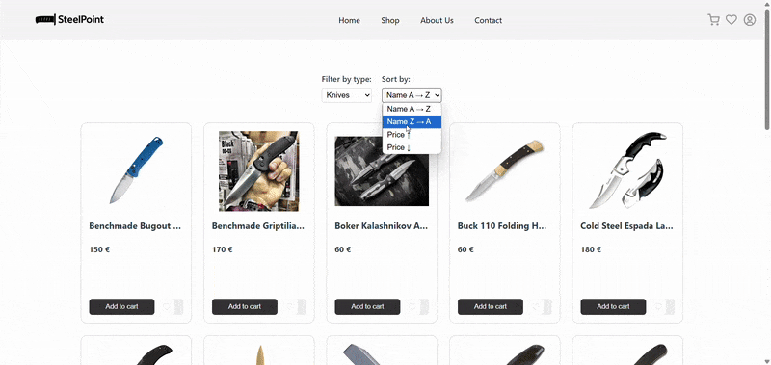
Examples of Use
Example of Use
Filtering and Sorting
Fig. 4 - Homepage product grid with active filtering
Valentin Ozerov
Individual Project

Slide 13
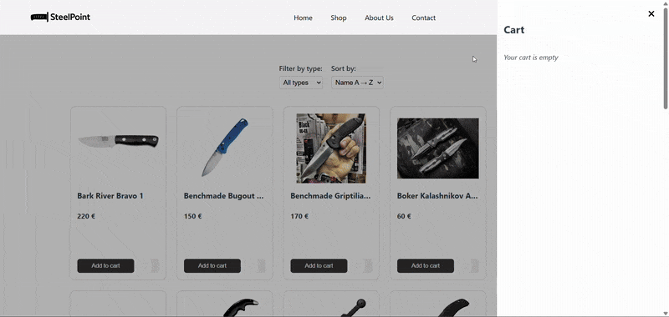
Example of Use II
Example of Use
Cart in Work
Fig. 5 - Opening the shopping drawer with multiple products
Valentin Ozerov
Individual Project

Slide 14
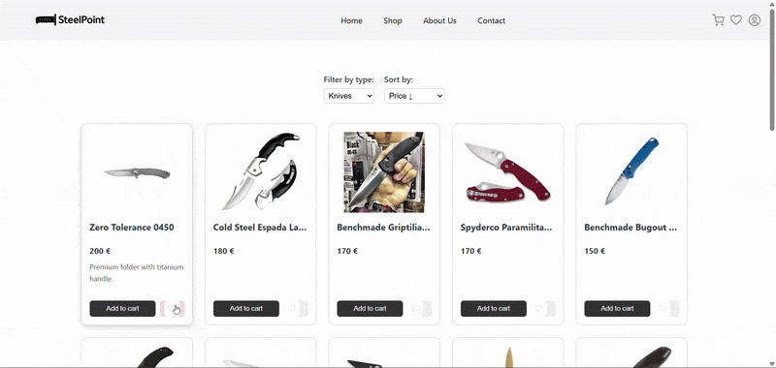
Example of Use III
Example of Use
Toggle Favorites Items
Fig. 6 - Adding/removing products from favorites and accessing favorites page
Valentin Ozerov
Individual Project

Slide 15
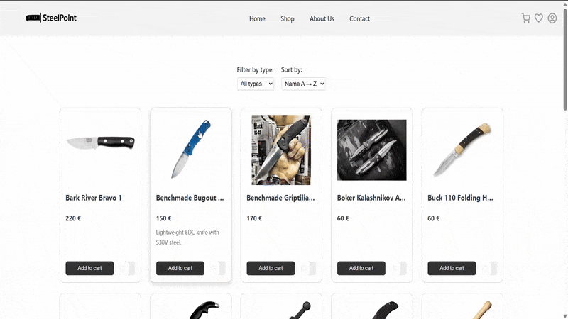
Example of Use IV
Example of Use
Product Detail Page Skeleton
Fig. 7 - Navigating to a product detail page (placeholder currently displayed)
Valentin Ozerov
Individual Project

Slide 16
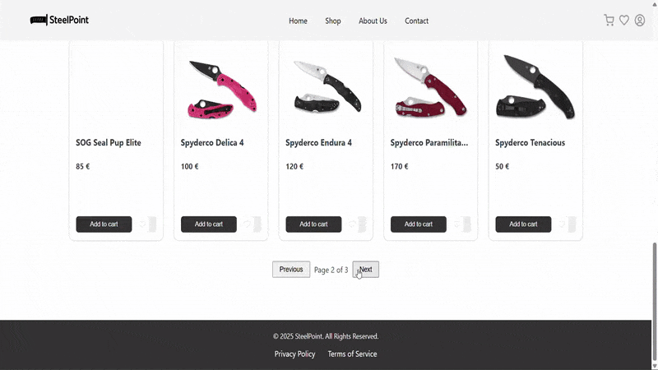
Example of Use V
Example of Use
Pagination on Main Page
Fig. 8 – Pagination in work on the Main Product Page
Valentin Ozerov
Individual Project

Slide 17
Future Plans
Future Plans
SteelPoint is designed as a scalable project. Planned improvements include:
Full development of product detail pages (with specifications and reviews)
Complete user profile system with login/registration and persistent favorites
Adding real order processing with payment integration (e.g., Stripe/PayPal)
Switching from in-memory database (H2) to PostgreSQL for production
Deployment on a stable hosting platform for public access
Valentin Ozerov
Foreign Language
Individual Project

Slide 18
References
References
Link to the projects repository
The full source code of the project is available at the Github public repository: https://github.com/ozerovvalya/SteelPoint
https://app.diagrams.net/ – used for drawing class diagrams
Valentin Ozerov
Individual Project

Slide 19

Valentin Ozerov
TSI University, 4301BDA group
Foreign Language
Individual Project

